Slide 1
Artificial heart and mechanically assisted circulatory support: hemolysis and wear evaluation in ceramic pivot bearings.
EDUARDO G. P. BOCK
IFSP – SAO PAULO, BRAZIL
sites.google.com/site/labbioeng/

Slide 2
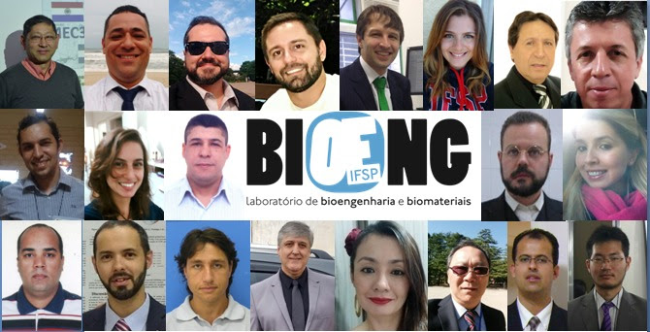
Laboratory of Bioengineering and Biomaterials BIOENG

Slide 3
Research lines
Artificial Organs
Computational Simulation in Bioengineering
Biomaterials and applications in Bioengineering

Slide 4
Artificial Heart and VADs
Introduction
ICBP mechanical support
INTERMACS and control
CFD and hemolysis
Surgical research
Biomaterials
Vibration and Friction
Left ventricle assist devices LVAD
We need
partners!
...engenharia inspirada na vida

Slide 5
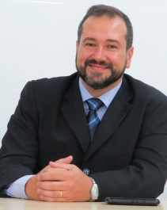
Eduardo Bock
Bachelor Mechanical Engineering, 2003.
IDPC and ATAH project
Ph.D. Mech. Eng. Unicamp, 2011 [1]
BCM, Houston, Yukihiko Nosé, 2006
Grants: IFSP PRP, 2012-13; CAPES
PGPTA (R$470k), 2014-17; CNPQ,
PRQ, 2015-18
[1] BOCK, E. Projeto, Construção e Testes de um Dispositivo de Assistência Ventricular: Bomba de Sangue Centrífuga Implantável, Doutorado em Engenharia Mecânica, FEM Unicamp, 2011.

Slide 6
Introduction
AMS Guardian, Ischemia detector (ST-PQ shift, impedance trend) [2, 3]
Lab. Bioengineering and Biomaterials - IFSP
http://sites.google.com/site/labbioeng/
[2] HOPENFELD, B. et al. The Guardian: An Implantable System for Chronic Ambulatory Monitoring of Acute Myocardial Infraction. Journal of Electrocardiology, 42(6):481–486, 2009.
[3] FISCHELL, T. et al. Initial Clinical Results Using Intracardiac Electrogram Monitoring to Detect and Alert Patients During Coronary Plaque Rupture and Ischemia. Journal of the American College of Cardiology, 56(14), 2010.

Slide 7
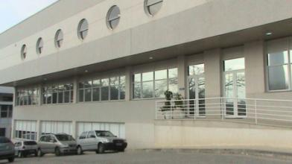
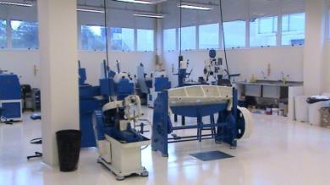
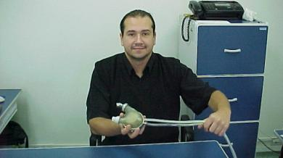
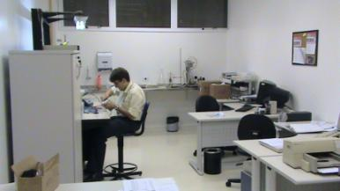
Beginning at Institute of Cardiology
IDPC

Slide 8
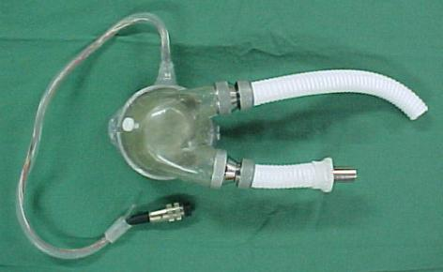
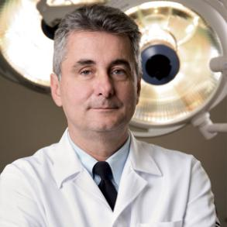
Electromechanical Total Artificial Heart
Prof. Aron Andrade IPDC/BCM 1996 [4]
Ph.D. Advisor / Co-Advisor
[4] HEMMINGS, S. et al. Improvement of the Control Mechanism of the Electromechanical Total Artificial Heart. Artificial Organs, 20(1):71, 1996.

Slide 9
ATAH - CAA
Artificial Heart, implantable, pulsatile
Electromechanical actuator, BLDC motor with pusher plates
Bovine pericardium valves [5]
Pumping unit in PU BioSpam
Tested in vivo (calves)
Ready for clinical study
[5] ANDRADE, A. et al. A Miniaturized Artificial Heart Working with the Natural Heart - The Auxiliary Total Artificial Heart (ATAH). Artificial Organs, 21(6):510, 1997.

Slide 10
Auxiliary Total Artificial Heart ATAH
Left Chamber
Diaphragm
Magnet
Pusher plate
Magnet
Screw
Plate
Screw
Axis
Sensor
Sensor
Sensor
Stator
Magnet
Stator
Rotor
Rotor
Pusher plate
Right cap
Right chamber

Slide 11
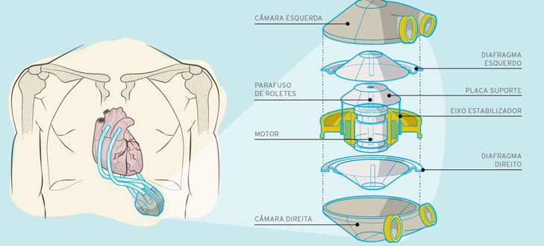
LVAD Left Ventricle Assist Device

Slide 12
LVAD Left Ventricle Assist Device
First
Second
Third

Slide 13
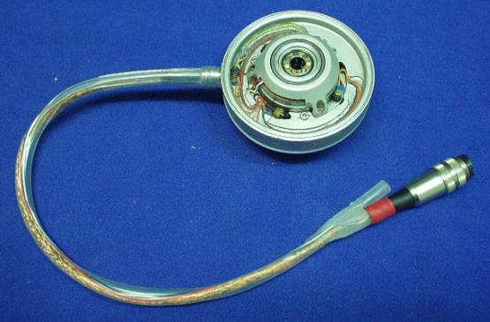
LVAD Left Ventricle Assist Device
Motor and windings, Hall sensors, passive fulfillment

Slide 14
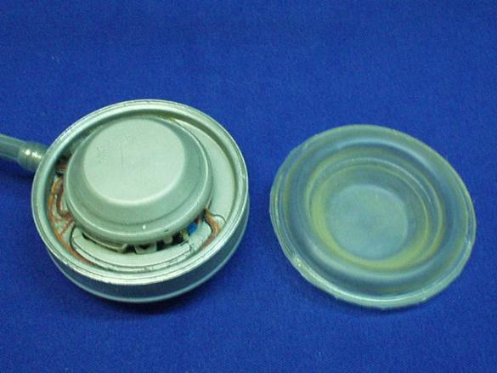
LVAD Left Ventricle Assist Device
Pusher plate and PU diaphragm

Slide 15
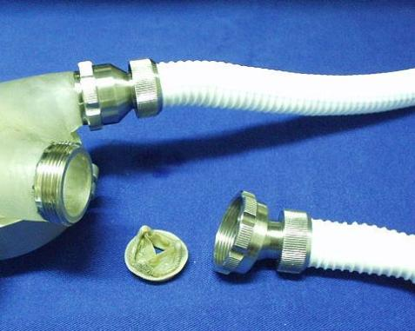
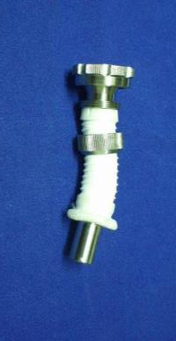
LVAD Left Ventricle Assist Device
Cardiac Valves placement and PTFE cannulae connection

Slide 16
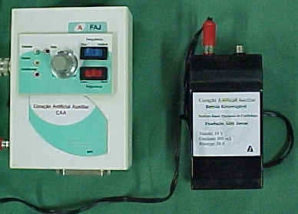
LVAD Left Ventricle Assist Device
First prototypes of Controller and external battery

Slide 17
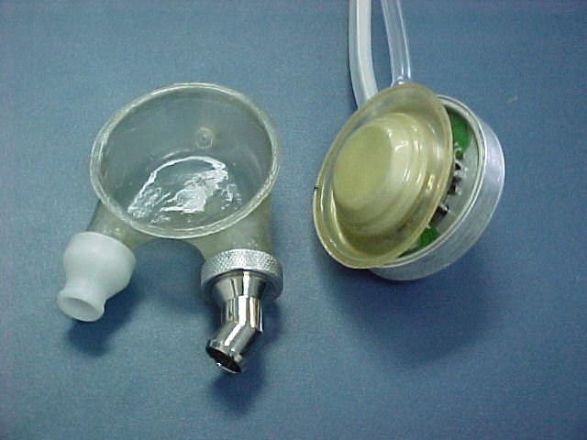
LVAD Left Ventricle Assist Device
Brushless DC Motor
Chamber
Biological
valves
PU diaphragm

Slide 18
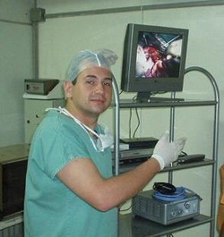
In vivo tests with ATAH as LVAD
27 calves 100 kg ± 20 kg

Slide 20
Bezerro nº |  | Data | Sobrevida (dias) | Resultados
1º | c/ CEC / BID | 05/06/2002 | 0 | Fibrilação ventricular (5.0.)
2º | c/ CEC / BID | 10/06/2002 | 5 | Não acordou, hipersecreção preliminar, infecção
3º | c/ CEC / BID | 20/08/2002 | 3 | Parada cardíaca súbita
4º | c/ CEC / BID | 06/11/2002 | 3 | Parada cardíaca súbita
5º | c/ CEC / BID | 27/11/2002 | 2 | Parada cardíaca súbita
6º | s/ CEC / BID | 18/02/2003 | 2 | Parada cardíaca súbita
7º | s/ CEC / BID | 15/05/2003 | 6 | Parada cardíaca súbita
8º | s/ CEC / BID | 07/10/2003 | 0 | Trauma respiratório (S.O.)
9º | s/ CEC / BID | 02/12/2003 | 6 | Falha controle dispositivo, Trombose cânulas (TCA)
10º | s/ CEC / BID | 25/05/2004 | 2 | Parada cardíaca súbita, Hematócrito baixo
11º | s/ CEC / BID | 13/07/2004 | 3 | Ruptura de diafragma do dispositivo
12º | s/ CEC / BID | 26/10/2004 | 0 | Dispositivo com obstrução na saída
13º | s/ CEC / BID | 07/12/2004 | 5 | Falha controle dispositivo, Hematócrito baixo, Insuficiência respiratória
15º | s/ CEC / BID | 05/04/2005 | 0 | Falha controle dispositivo (S.O.)
16º | s/ CEC / BID | 16/08/2005 | 5 | Distúrbio eletrolítico
17º | s/ CEC / BID | 29/11/2005 | 5 | Soltura de bucha roscada do dispositivo
18º | s/ CEC / BID | 06/12/2005 | 3 | Soltas bucha roscada do dispositivo (carcaça amolecida)
21º | s/ CEC / BID | 14/08/2007 | 1 | Sangue no motor do dispositivo , Sem recuperação ou alimentação, Animal sacrificado
22º | s/ CEC / BID | 05/08/2008 | 1 | Ruptura diafragma dispositivo, Animal sacrificado
24º | s/ CEC / BID | 10/02/2009 | 0 | Fibrilação ventricular (S.O.)
25º | s/ CEC / BIT | 10/08/2009 | 1 | Parada respiratória por extubação precoce
27º | s/ CEC / BIT | 17/11/2009 | 1 | Choque séptico + enterite hemorrágica
CEC – circulação extracorpórea BID – bolsa intradiafragmática BIT – bolsa intratorácica

Slide 21
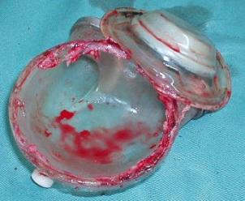
Bezerro nº |  | Data | Sobrevida (Dias) | Resultados
14º | s/ CEC / BID | 01/03/2005 | 7 | Desfragmentação imã do motor com travamento do dispositivo
23º | s/ CEC / BID | 14/10/2008 | 7 | Parada Respiratória
19º | s/ CEC / BID | 30/05/2005 | 12 | Problemas no dispositivo (conector com falhas) + infecção
20º | s/ CEC / BID | 28/11/2006 | 16 | Insuficiência respiratória + infecção
26º | s/ CEC / BIT | 29/09/2009 | 31 | “Leaks” paraprotético no dispositivo
CEC – circulação extracorpórea BID – bolsa intradiafragmática BIT – bolsa intratorácica

Slide 22
SCENARIO
Lean structure leads to some mistakes
Teams: Surgical, Clinicians, Veterinary, Engineering and Scientists
Many experiments wasted
Research started in 1996 (clinical evaluation)
In Brazil, there is research but it doesn’t reach the market (devices are imported!)

Slide 23
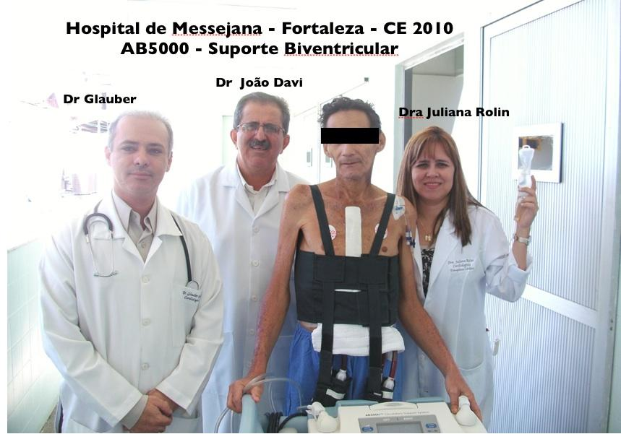

Slide 24
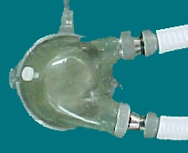
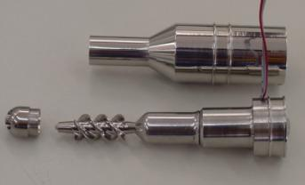
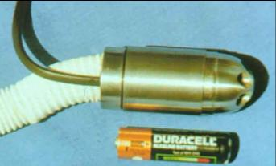
Brazilian Devices in 00’s
1st Generation
CAA - IDPC
Braile
2 nd Generation
INCOR
INCOR Curitiba

Slide 25
LVAD - INCOR
Pulsatile, pneumatic driven, paracorporeous [6]
[6] Oshiro, M. et al. Design, manufacturing, and testing of a paracorporeal pulsatile ventricular assist device: São Paulo Heart Institute VAD. Artificial Organs, 19(3):274-9, 1995.

Slide 26
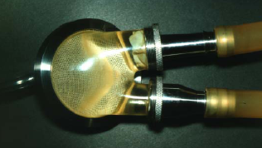
LVAD - INCOR

Slide 27
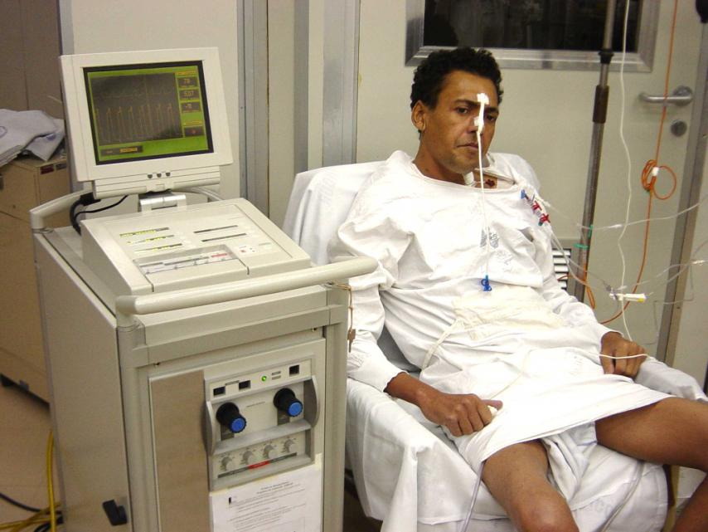

Slide 28
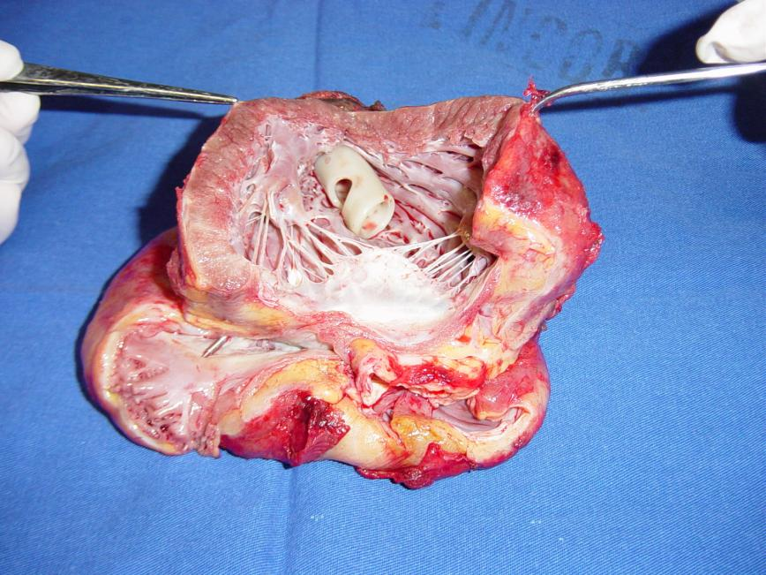

Slide 29
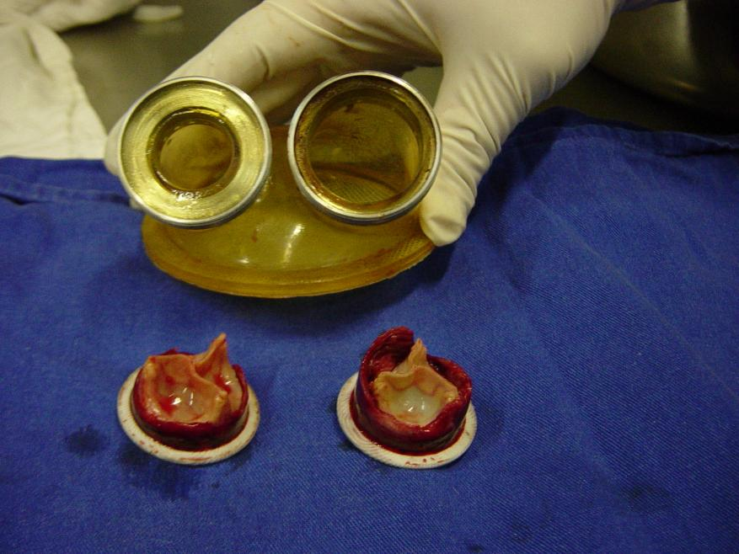

Slide 30
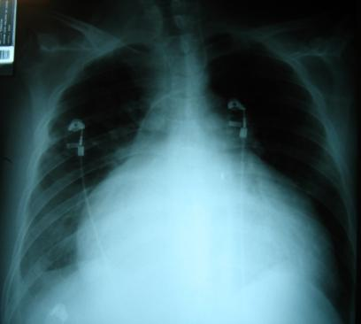
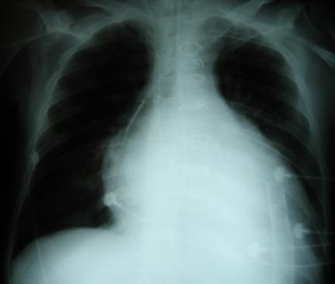
Clinical Experience
Pre Assistance
7 days after assistance

Slide 31
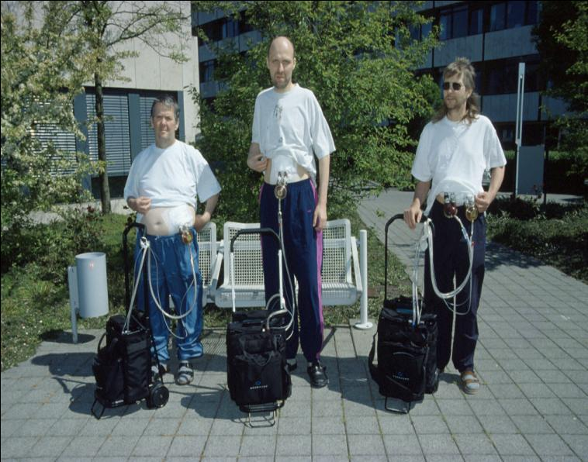

Slide 32
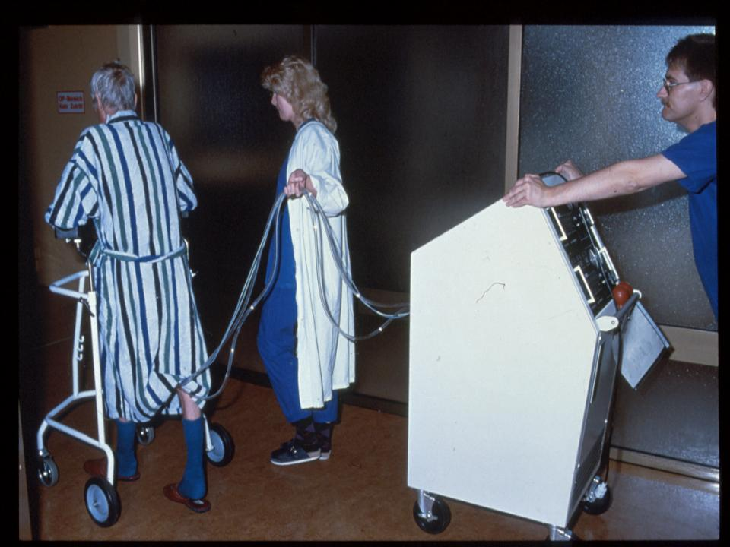

Slide 33
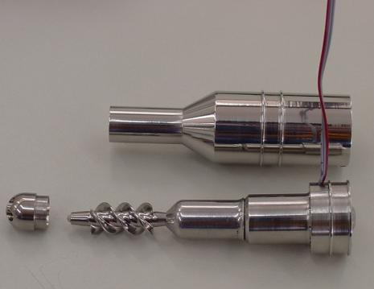
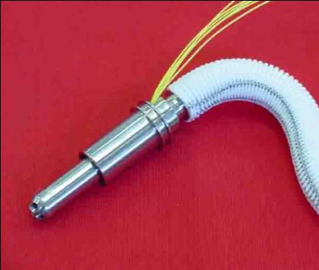
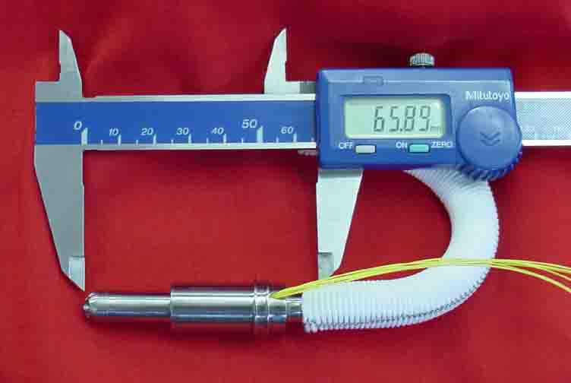

Slide 34
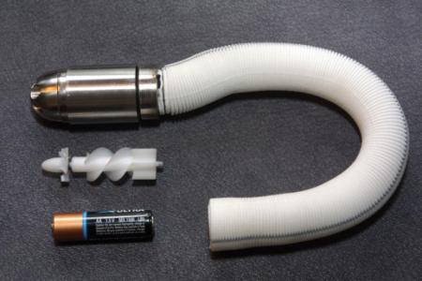
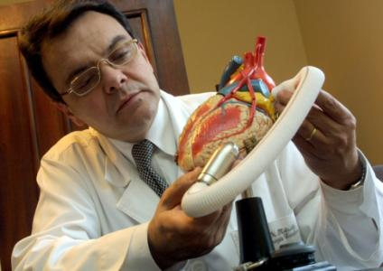
K-PUMP
Stainless steel, INCOR Curitiba [7]
Jarvik 2000
[7] KUBRUSLY, L. et al. Dispositivo de assistência circulatória mecânica intraventricular de fluxo axial: estudo in vitro. Revista Brasileira de Cirurgia Cardiovascular, 15(2): 169-72 , 2000.

Slide 35
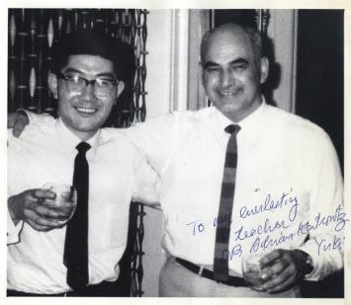
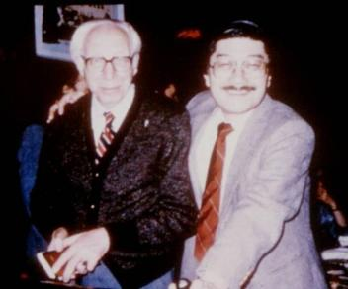
BAYLOR COLLEGE OF MEDICINE
New VAD project started in 2006 (ICBP)
“Mr Artificial Organs” pioneer Yukihiko Nosé
A. Kantrowitz W. Kolff

Slide 36
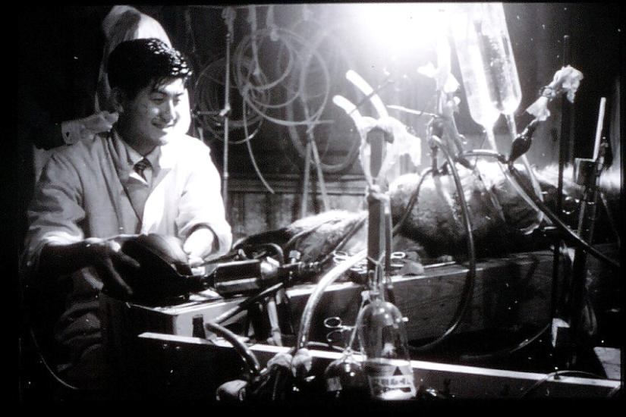
Unlimited Curiosity, Unlimited Enthusiasm, Unlimited Optimism, and Unlimited Friendship.

Slide 37
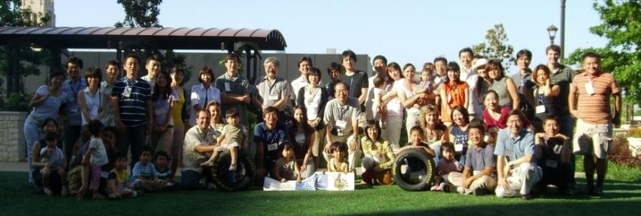
BAYLOR COLLEGE OF MEDICINE
Founded several societies, wrote more than 1200 papers, 100 book chapters and around 20 books [8].
[8] MALCHESKY, P. e MOTOMURA, T. Yukihiko Nosé: Mr Artificial Organs. Therapeutic Apheresis and Dialysis, 16(1):1–10, 2012.

Slide 38
PREVIOUS IDEAS
Already had 2 axial pumps but no Implantable Centrifugal
Centrifugal Blood Pump was only for ECC like Biopump and Spiral Pump (SP) [9].
Inlet angle, concentrically or not.
Fluid Dynamics to predict hemolysis
[9] ANDRADE, A. et al. Characteristics of a Blood Pump Combining the Centrifugal and Axial Pumping Principles: The Spiral Pump. Artificial Organs, 20(6):605-612, 1996.

Slide 39
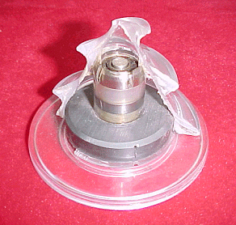
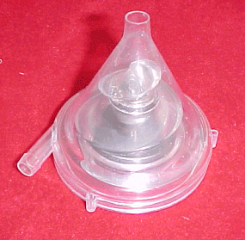
PREVIOUS IDEAS
SP conversion into ICBP [10].
[10] BOCK, E. et al. A new concept of centrifugal blood pump using pivot bearing system: the conversion of the Spiral Pump inlet port. ABCM Symposium Series in Bioengineering, 1:I.09, 2005.

Slide 40
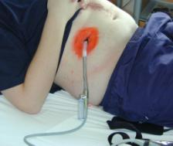
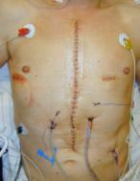
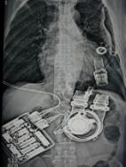
PREVIOUS IDEAS
Avoid impeller in axis, seal and leaking problems.
Ceramic Bearings and Titanium.
Reduced Size, in order to be implanted.
Applied as VAD no ECC.

Slide 41
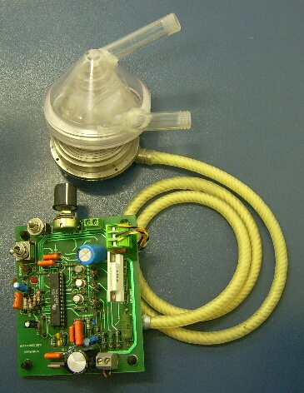
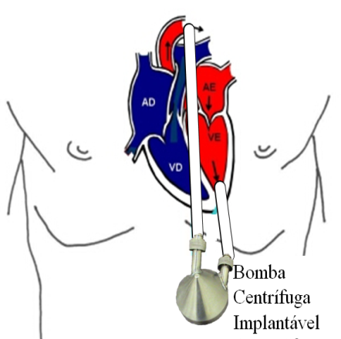
IMPLANTABLE CENTRIFUGAL BLOOD PUMP (ICBP)
PI 0706163-3
ICBP

Slide 42
ICBP
Mixed flow pump (centrifugal + axial)
Maintained cone in spiral shape and centrifugal vanes
Tribology Al₂O₃ + PEUAMM (attenuate vibration)
First prototype was paid by YN
Hemolysis test with my own blood [11]
[11] BOCK, E. et al. New Centrifugal Blood Pump With Dual Impeller and Double Pivot Bearing System: Wear Evaluation in Bearing System, Performance Tests, and Preliminary Hemolysis Tests. Artificial Organs, 32(4):329–333, 2008.

Slide 43
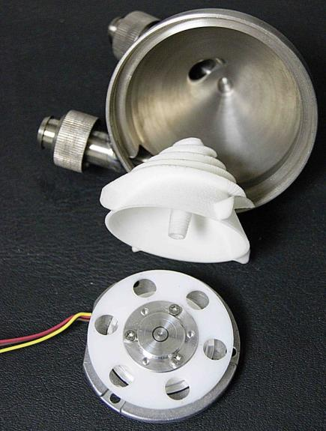
ICBP
Cone made of Ti
Rotor
Magnetic Coupling
Motor

Slide 44
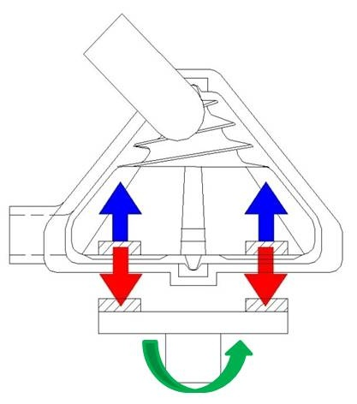
ICBP
Top pivot
Original design
ICBP
Lower pivot
Magnetic
Coupling
Mixed flow pump:
Centrifugal and axial principles
speed
Magnetic attraction
Hydraulic
Levitation

Slide 45
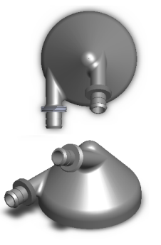
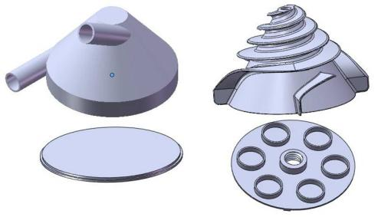
ICBP
Design characteristics
Originality [12].
[12] BOCK, E. Equipamento implantável de suporte temporário à vida de pacientes em espera para o transplante cardíaco. INPI, PI-0706163, 2009.

Slide 46
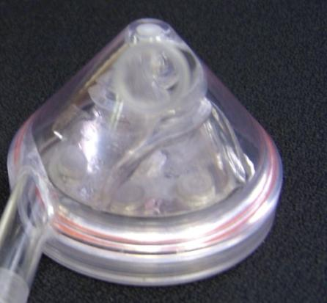
Machined Prototypes
2
1

Slide 47
Machined Prototypes
3

Slide 48
Others in Brazil
Bruno Utiyama IDPC – Adib Jatene [13]
Pai Chi Nan EPUSP – H. A. Einstein [14]
[13] SILVA, B. et al. In Vitro Assessment of the Apico Aortic Blood Pump: Anatomical Positioning, Hydrodynamic Performance, Hemolysis Studies, and Analysis in a Hybrid Cardiovascular Simulator. Artificial Organs, 37:950-953, 2013.
[14] NAN, P. et al. Development of a Compact Maglev Centrifugal Blood Pump Enclosed in a Titanium Housing. Journal of Advanced Mechanical Design, Systems and Manufacturing, 2(3):343-355, 2008.

Slide 49
Jatene

Slide 50
Jatene

Slide 51
Research at Labbioeng
Tarcísio, Breno, J. Ricardo Control
Marcelo, Miriam ANN/EKG
Guilherme, Luciano, Mariana CFD
Rosa, Mizael, Michele BIOMATERIALS
Joaquim, Ricardo, Bruno MACHINING
Rogério ACTUATOR
Aumir, Antonio, Araki, Dryelle WEAR/FRICTION
http://sites.google.com/site/labbioeng/

Slide 52
CONTROL
BLDC Motors
Simulator
Customization
Flexibility of operation
Local Control and supervisory [15]
ANN
[15] CAVALHEIRO, A. et al. Design of Supervisory Control System for Ventricular Assist Device. Advances Information Communication Technology, 375-382, 2011.

Slide 53
BRUSHLESS MOTOR
BLDC direct current and 3 phases
Reliable and high durability
Windings are induced commuting phases by electronic drive
Modeling the system dynamics behavior [16]
[16] LEÃO, T. et al. Speed control of the Implantable Centrifugal Blood Pump to avoid aortic valve stenosis: Simulation and implementation. Biomedical Robotics and Biomechatronics, 5:82-86, 2014.

Slide 54
BRUSHLESS MOTOR
Schima made in Ostrich
Maxxon industrial motors (EC45 Flat, Maxxon, Sachseln, Switzerland)
EPUSP model

Slide 55
BRUSHLESS MOTOR

Slide 56
BRUSHLESS MOTOR

Slide 57
BRUSHLESS MOTOR

Slide 58
TESTE COM DINAMÔMETRO
Instrumento indicador
Visor indica torque em $\left[\text{mN}\text{∙}\text{m}\right]$
Visor indica força axial em $\left[\text{N}\right]$
Fonte de alimentação
Placa controladora
Tacômetro digital
Disco do freio magnético
Atuador
Placa adaptadora
Subconjunto reativo
Subconjunto freio magnético
Parafuso

Slide 59
BRUSHLESS MOTOR

Slide 60
CARDIOVASCULAR SIMULATOR

Slide 61
CARDIOVASCULAR SIMULATOR

Slide 63
CARDIOVASCULAR SIMULATOR
Hybrid: physical (hydrodynamic) and virtual (simulated in computer) [17]
Characteristics: pressure, flow, resistance and vascular complacency.
Mimics only left ventricle
Composed by: propulsion system; circulation; data acquisition; signal analysis and processing
[17] FONSECA, J. et al. Cardiovascular Simulator Improvement: Pressure Versus Volume Loop Assessment. Artificial Organs, 35(5):454-458, 2011.
[18] UEBELHART, B. et al. Study of a Centrifugal Blood Pump in a Mock Loop System. Artificial Organs, 37(11): 946-949, 2013 .

Slide 64
CARDIOVASCULAR SIMULATOR
Flow in aorta

Slide 65
CFD
Mathematical modeling, Tada, Fuentes e Mariana Hernandes
Legendre EPUSP – IDPC
Antunes IDPC
Guilherme Lopes Jr EESC - USP

Slide 66
MODELING
MATLAB to solve numerically
Motor power [19]
[19] TADA, E. et al. A mathematical model for flow analysis of an Implantable Centrifugal Blood Pump. 2º OBI - Taller de Órganos Artificiales, Biomateriales e Ingeniería de Tejidos, Mar del Plata, 2011.

Slide 67
CFD
First studies [20]
[20] LEGENDRE, D. et al. Computational Fluid Dynamics Investigation of a Centrifugal Blood Pump. Artificial Organs 32(4):342–348, 2008.

Slide 68
COMPUTATIONAL FLUID DYNAMICS
New pumps, rotor only with vanes [21]
[21] LÉO, L. et al. Análise por CFD do escoamento de Bombas de Sangue Centrífugas em plataforma integrada CAD/CAE. Revista Sinergia, 15(2):105-114, 2014.

Slide 69
COMPUTATIONAL FLUID DYNAMICS
ICBP (turbulence models with hemolysis prediction)
EESC USP

Slide 70
PIV Validation

Slide 71
HEMOLYSIS PREDICTION AND VALIDATION
Normalized Index of Hemolysis
Harboe Method and TMB methods

Slide 72
NORMALIZED INDEX OF HEMOLYSIS
Experimental set for NIH measurements

Slide 73
NORMALIZED INDEX OF HEMOLYSIS
Plasma Free Hemoglobin [22]
[22] BOCK, E. et al. Implantable Centrifugal Blood Pump With Dual Impeller and Double Pivot Bearing System: Electromechanical Actuator, Prototyping, and Anatomical Studies. Artificial Organs, 35(5):437–442, 2011.

Slide 74
NORMALIZED INDEX OF HEMOLYSIS
NIH in 4 samples
NIH resulted in 0,0054 ± 2,46.10⁻³ mg/100L

Slide 75
EXPERIMENTAL SURGERY
Animal model
Surgical Instruments
Surgical Techniques
Animal care
Ethics Committee (for animal experiments)

Slide 76
EXPERIMENTAL SURGERY
Device for cannulae insertion in Left Ventricle

Slide 77
EXPERIMENTAL SURGERY
Anatomical studies with animals and cadavers
Thoracic implantation
Abdominal implantation (abdominal aorta)
Abdominal implantation (descending aorta)

Slide 83
BIOMATERIALS
3D Printing
Hemolysis INH with ASTM Standards
Thrombogenesis - CFD
Ceramic Pivot Bearings
Wear and Friction
Titanium surface treatment

Slide 84
3D PRINTING

Slide 85
MACHINING

Slide 86
WEAR AND FRICTION
Workbench

Slide 87
WEAR AND FRICTION
Vibration
35Hz
70Hz
105Hz

Slide 88
WEAR AND FRICTION
Optical Microscopy

Slide 89
PLASMA ELECTROLICTIC OXIDATION
Titanium
SEM

Slide 90
Thanks!

Slide 91
Muito
Obrigado!

Slide 92
eduardo_bock@yahoo.com.br

